Slide 1
Quality of 2016 US Mortality Data
Week 2 Update

Slide 2
ANACONDA Index
1.* Completeness of death registration
- this is unimportant for our dataset
2. Fraction of ‘garbage’ codes in the data
3.* Amount of COD detail in the COD list used
- The ANACONDA model simply calculates the number of different categories used for underlying cause of death rather than looking at the number of secondary factors listed. I think both are interesting
4.* Extent to which age and sex of deceased are not recorded
5.* Number of biologically implausible causes found in the data (i.e. highly unlikely of impossible causes for a given age-sex category)
I think only fraction of ‘garbage’ codes is useful in our case and maybe amount of COD detail.
The final index is calculated as: completeness_score * (1 - garbage_fraction) * level_of_detail * (1 - missing_age_sex) * (1 - implausible_codes)

Slide 3
Summary of Things I Looked At
1.* Completeness of death registration
- this is unimportant for our dataset
2. Fraction of ‘garbage’ codes in the data
3.* Amount of COD detail in the COD list used
- The ANACONDA model simply calculates the number of different codes used for underlying cause of death rather
4. * Number of biologically implausible causes found in the data (i.e. highly unlikely of impossible causes for a given age-sex category)
5. Autopsy frequency
6. Average number secondary factors recorded.
7. Frequency that one or no secondary factors were recorded.
Ones in red are not part of ANACONDA
* Less relevant for United States
Is there a way to evaluate if some secondary codes are better than others?

Slide 4
Data is complete (or very close)
The ANACONDA completeness model finds that the US mortality data is 98% complete which is within a standard error of 100% (the model has uncertainty of 3-5%).
Measuring exactly how complete US mortality is would require a more precise model.

Slide 5
Biologically Implausible Codes
The ANACONDA model looks at garbage codes as well as biologically implausible codes (age / sex combination). The Ellingsen paper on Norway assumes that the number of biologically implausible codes is incredibly small (<3% according to ANACONDA model) so it ignores them.
I think the same assumption can be made about the United States data.
(Having difficulty finding a list of biologically implausible codes to test this.)

Slide 6
Fraction of Garbage Codes and GBD Severity Profile
In 2016, 8.2% of codes were garbage (underlying cause of death)
GBD Severity | Deaths | Share (of garbage codes)
1 | 92876 | 41.3%
2 | 27631 | 12.2%
3 | 40578 | 18.06%
4 | 63567 | 28.3%

Slide 7
Demographics and Percentage Garbage Codes
Race | Percentage garbage codes (%)
White | 8.1
Black | 8.8
Indigenous | 8.8
Asian or Pacific Islander | 7.5
Sex | Percentage garbage codes (%)
Female | 8.2
Male | 8.1
Marital Status | Percentage garbage codes (%)
Single | 13.7
Unknown | 12.9
Divorced | 8.8
Widowed | 7.1
Married | 6.7

Slide 8
Education Status | Percentage garbage codes (%)
8th grade or less | 7.3
9th - 12th grade, no diploma | 9.0
High school graduate or GED completed | 8.4
Some college credit, but no degree | 8.5
Associate degree | 8.0
Bachelor’s degree | 7.1
Master’s degree | 6.5
Doctorate or professional degree | 6.3
Unknown | 10.1
Day of the Week | Percentage garbage codes (%)
Monday | 8.2
Tuesday | 8.0
Wednesday | 8.0
Thursday | 8.1
Friday | 8.1
Saturday | 8.4
Sunday | 8.3
Unknown | 14.1

Slide 9
Place of Death | Percentage garbage codes (%)
Hospital, clinic or Medical Center - Inpatient | 7.1
Hospital, Clinic or Medical Center - Outpatient or admitted to Emergency Room | 10.0
Hospital, Clinic or Medical Center - Dead on Arrival | 15.0
Decedent’s home | 9.0
Hospice facility | 7.1
Nursing home/long term care | 6.8
Other | 12.5
Unknown | 12.0
8.1% of people who have at least one secondary factor listed have a garbage code (same as overall average).

Slide 10
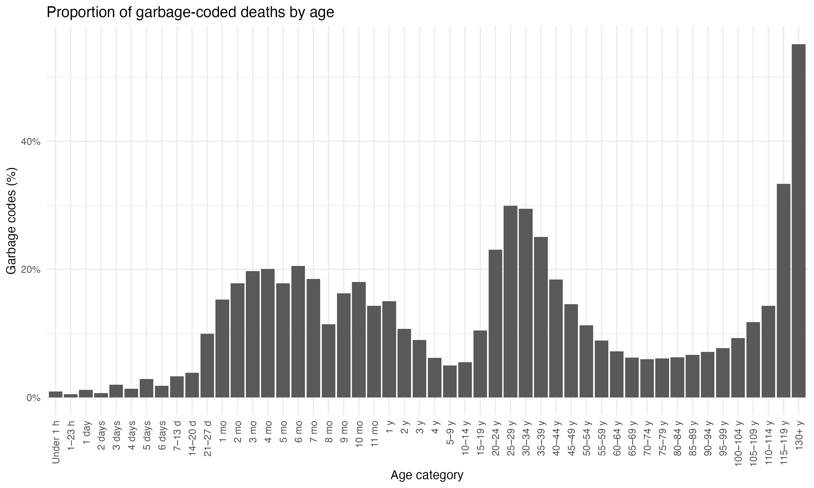

Slide 11
What are GBD severities?
Class 1 comprises GCs that could be redistributed to any UCoD in any of the three Level 1 cause groups of diseases and injuries (e.g. sepsis): Communicable diseases, non-communicable diseases and Injuries. They are the most difficult to redistribute and require the most modelling.
Class 2 comprises GCs that could be redistributed to any UCoD in one or two of the three Level 1 cause groups of diseases and injuries (e.g. unspecified and undetermined intent of injury).
Class 3 includes GCs for which the UCoD is likely part of the same ICD chapter (e.g. CUP).
Class 4 is the one with less policy implications and identifies GCs for which the UCoD is likely to be attributed to a single disease or injury (e.g. unspecified type of stroke).
Note that the IHME GBD severity typology is designed to assess the impact of a garbage code on global health statistics. We may want to make our own typology specific to high income countries like the US.
Source: Monasta, L., Alicandro, G., Pasovic, M., Cunningham, M., Armocida, B., JL Murray, C., ... & Naghavi, M. (2022). Redistribution of garbage codes to underlying causes of death: a systematic analysis on Italy and a comparison with most populous Western European countries based on the Global Burden of Disease Study 2019. European Journal of Public Health, 32(3), 456-462.

Slide 12
Top 11 Garbage Codes in 2016
(underlying cause of death)
ICD10 | Description | GBD Severity Index | Deaths | Share (of garbage codes)
I64 | Stroke, not specified as haemorrhage or infarction | 4 | 61818 | 27.5%
C80 | Malignant neoplasm without specification of site | 3 | 27845 | 12.4%
X42 | Accidental poisoning by and exposure to narcotics and psychodysleptics [hallucinogens], not elsewhere classified | 1 | 26195 | 11.7%
X44 | Accidental poisoning by and exposure to other and unspecified drugs, medicaments and biological substances | 1 | 23980 | 10.7%
I10 | Essential (primary) hypertension | 2 | 21308 | 9.5%
R99 | Ill-defined and unknown cause of mortality | 1 | 13381 | 6.0%
N19 | Unspecified kidney failure | 1 | 8832 | 0.3.9%
C55 | Malignant neoplasm of uterus, part unspecified | 3 | 5329 | 2.4%
C97 | Malignant neoplasms of independent (primary) multiple sites | 3 | 4852 | 2.1%
X41 | Accidental poisoning by and exposure to antiepileptic, sedative-hypnotic, antiparkinsonism and psychotropic drugs, not elsewhere classified | 1 | 4621 | 2.0%
R54 | Age-related physical debility | 1 | 4228 | 1.9%

Slide 13
COD detail
In ANACONDA this is simply the fraction of all possible underlying cause of death codes (according the IHME) that are used in the death registry. I get a COD detail only 33% for the United States in 2016, which seems very small so I’m wondering if this is wrong – will return to it.
How useful is this metric?

Slide 14
Number of Secondary Factors
The average number of listed secondary factors was 1.99
Race | Average # of Secondary Factors Listed
White | 1.99
Black | 1.95
Indigenous | 2.33
Asian or Pacific Islander | 1.97
Sex | Average # of Secondary Factors Listed
Female | 1.92
Male | 2.06

Slide 15
Average Number of Secondary Factors by Cause of Death
Top 10 Causes of Death in order (of 39 codes) | Average # of Secondary Factors
Assault (homicide) | 2.3
Cerebrovascular diseases | 2.2
Atherosclerosis | 1.8
Diabetes mellitus | 1.5
Nephritis, nephrotic syndrome, and nephrosis | 2.4
Malignant neoplasm of breast | 1.7
Influenza and pneumonia | 1.8
Certain conditions originating in the perinatal period | 3.2
Major cardiovascular diseases | 1.4
Alzheimer’s disease | 2.8
Marital Status | Average # of Secondary Factors
Single | 2.0
Unknown | 2.1
Divorced | 2.1
Widowed | 1.9
Married | 2.0
Education status similarly shows little differences.

Slide 16
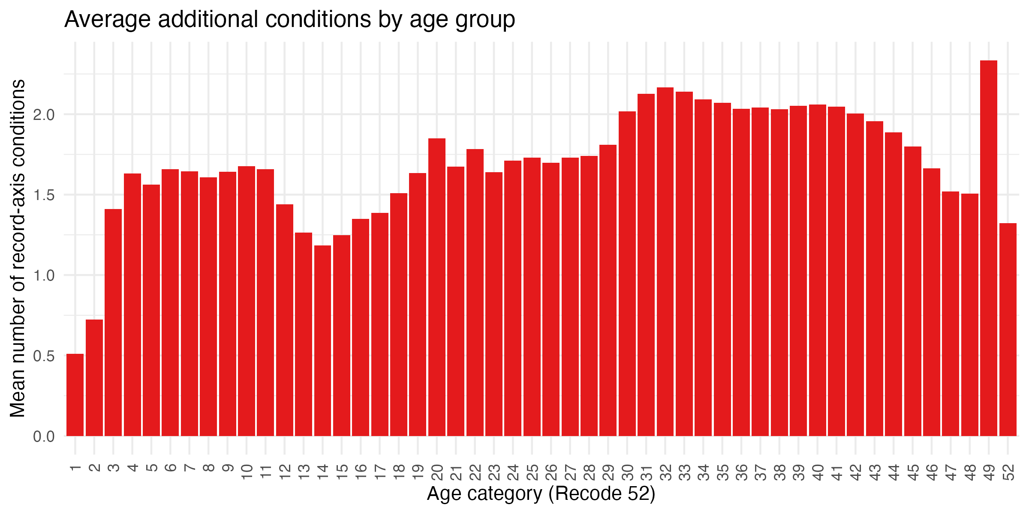
Education Status | Average # of Secondary Factors Listed
8th grade or less | 1.97
9th - 12th grade, no diploma | 2.07
High school graduate or GED completed | 2.01
Some college credit, but no degree | 2.03
Associate degree | 1.98
Bachelor’s degree | 1.89
Master’s degree | 1.83
Doctorate or professional degree | 1.85
Unknown | 2.02

Slide 17
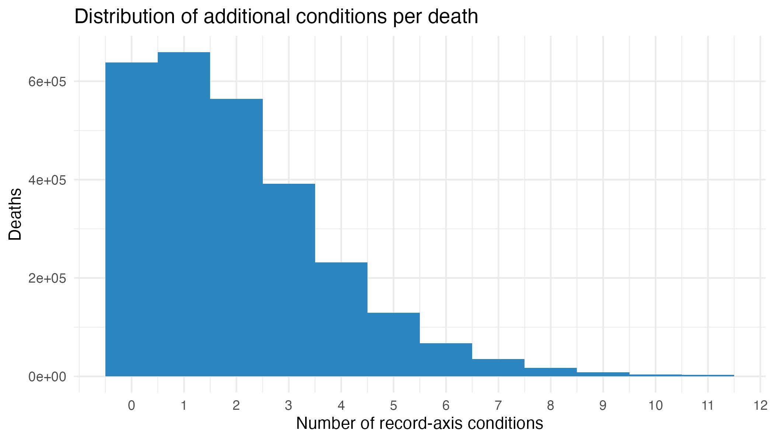
The bulk of people have just a couple secondary factors listed and many have none.
Perhaps the higher number of secondary factors among men and negligible differences reflects a trade-off where some lower-income people receive worst care so less factors are listed but also have more secondary conditions which obscures a pattern in summary statistics. Rather than look at the average number of secondary factors maybe we should be looking at the frequency of 0 or 1 secondary factors.

Slide 18
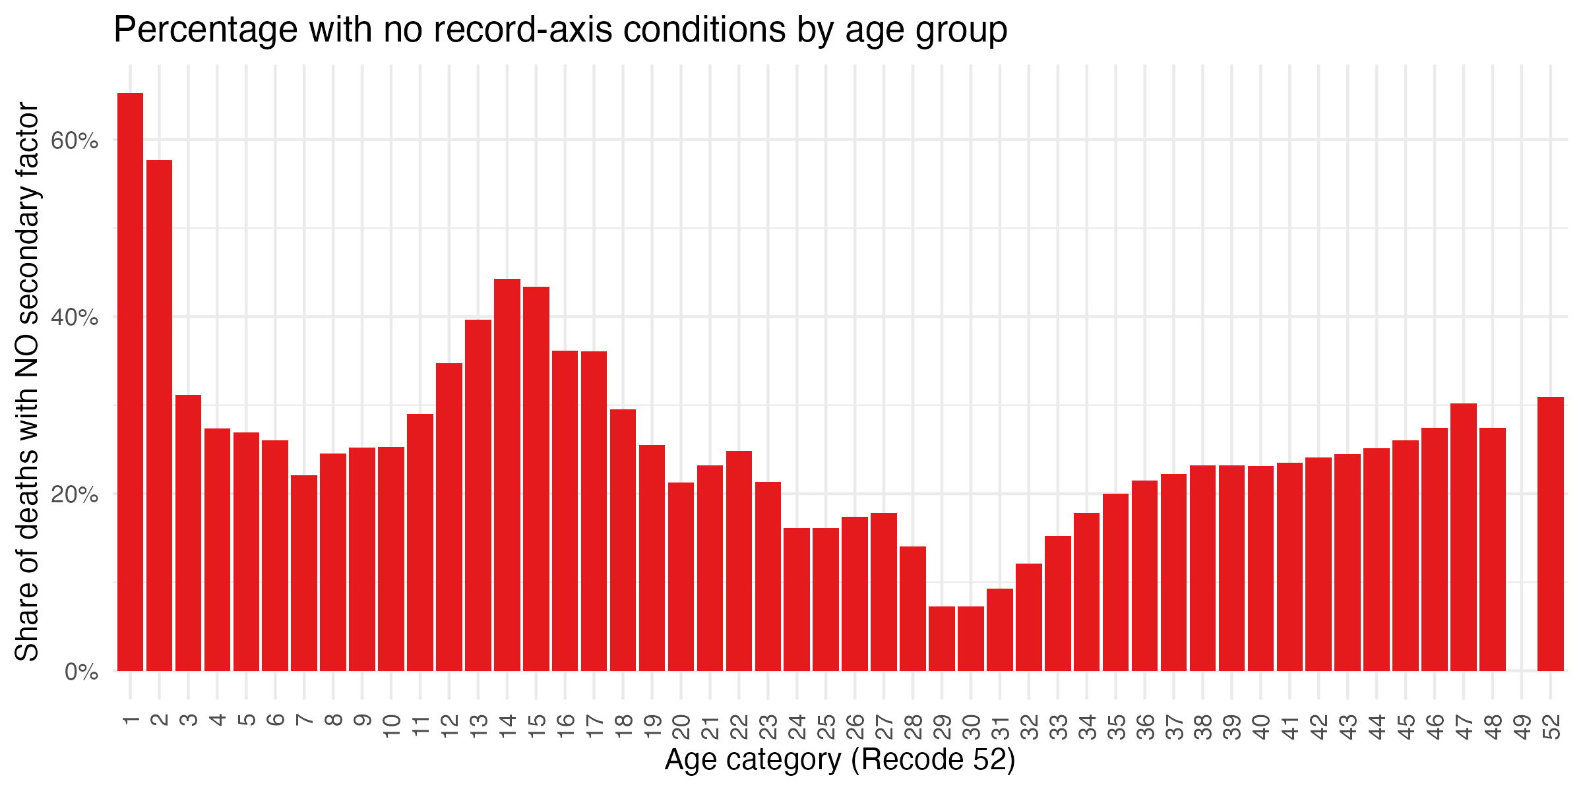
Proportion with 0 secondary factors listed
The average number of listed secondary factors was 1.99
Race | Percentage with 0 secondary factors listed
White | 23.3%
Black | 23.6%
Indigenous | 16.5%
Asian or Pacific Islander | 22.0%
Sex | Average # of Secondary Factors Listed
Female | 25.3%
Male | 21.3%
Women are about 4% more likely to have 0 secondary factors listed. This drops to 1.5% when age and underlying cause of death are controlled for.

Slide 19
Proportion with 0 secondary factors listed
Marital Status | Expected change in likelihood of having no extra factors against divorced (baseline) (controlling for age) (%)
Single | -1.7%
Unknown | -1.3%
Widowed | 3.2%
Married | 2.7%
Marital Status | Proportion with 0 secondary factors
Single | 0.200
Unknown | 0.203
Divorced | 0.214
Widowed | 0.246
Married | 0.240
When controlling for age, it seems that single people are must more likely to have 0 secondary factors listed.

Slide 20
Autopsies

Slide 21
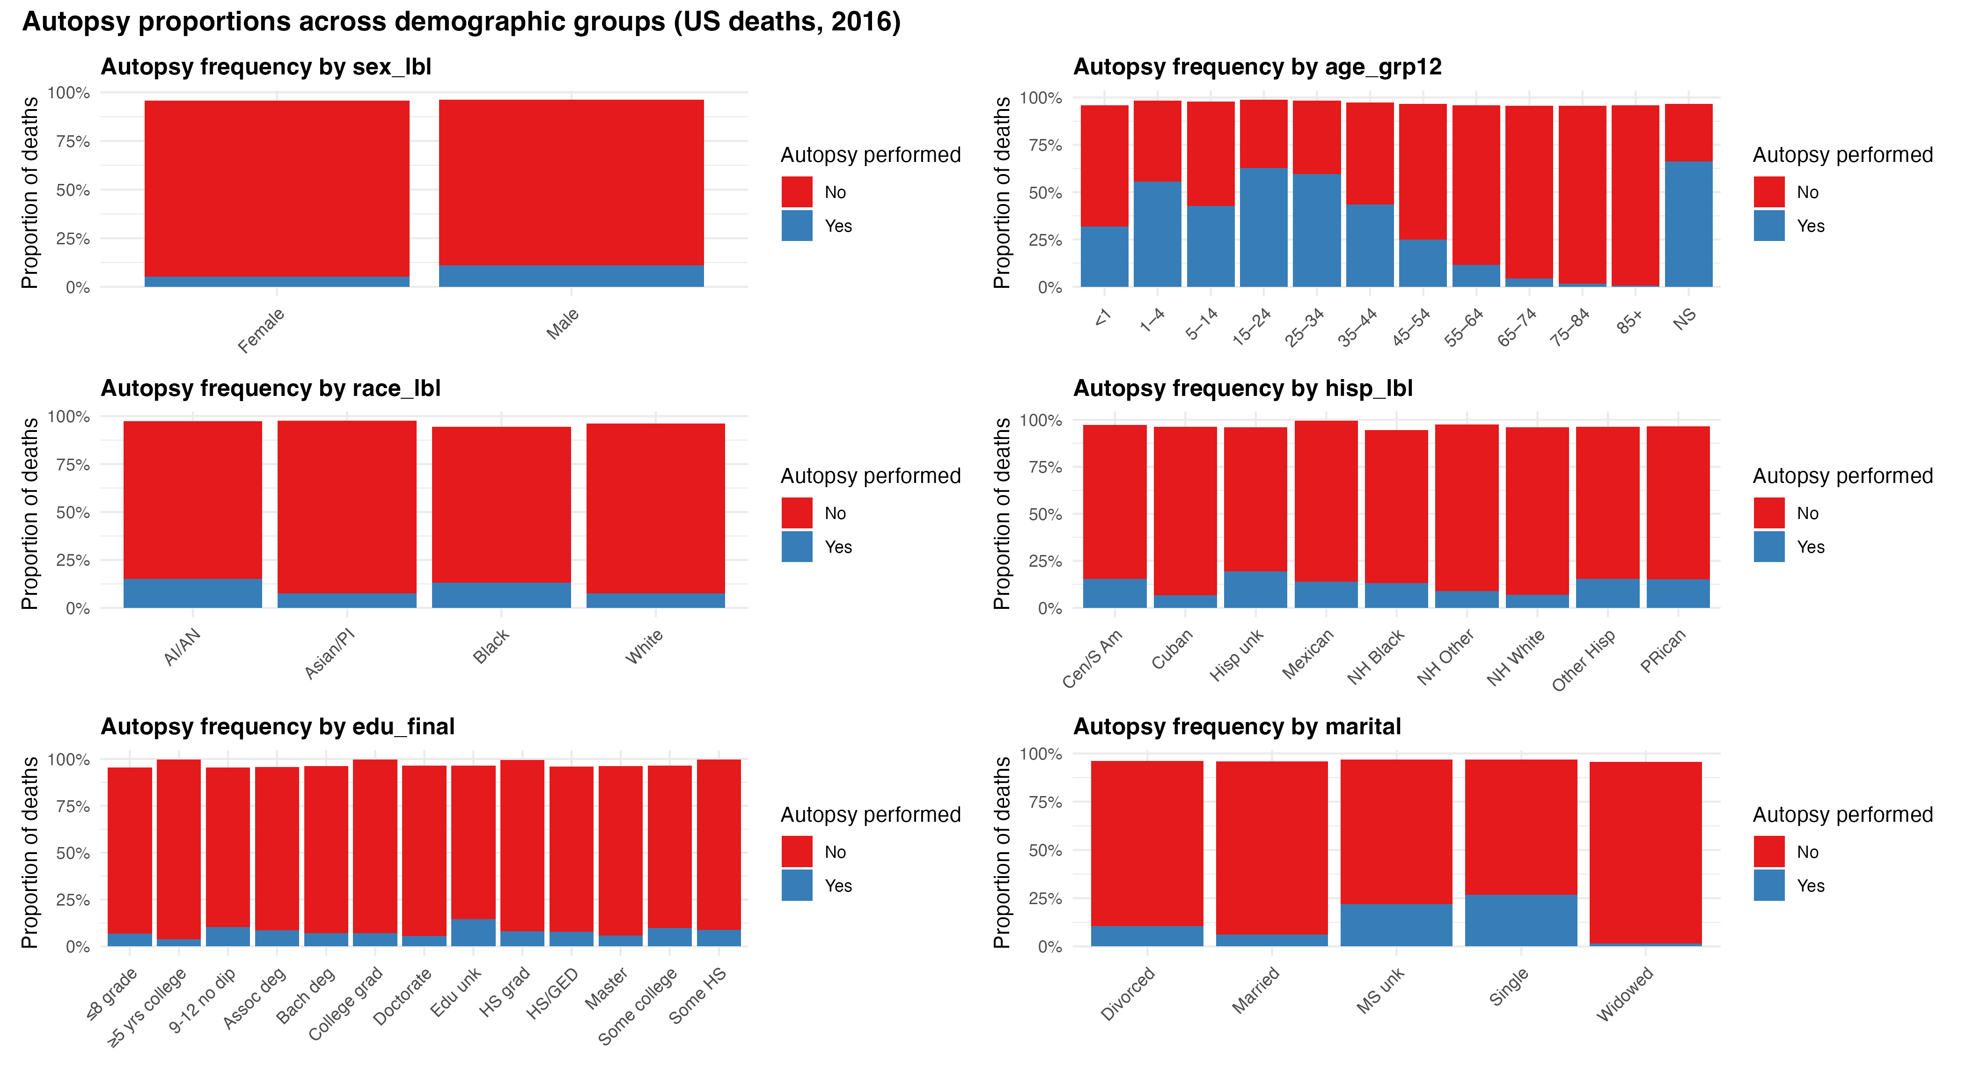

Slide 22
Men were more than twice as likely as women to be autopsied (11.6% v.s. 5.4%).
Some of this is explained by men dying younger and likely also that they die less “natural” CODs which are more likely autopsied (see the extra charts at the end with the frequency of autopsy for each 113 types of CODs).
After controlling for age of death, there remains a 3% difference in the likelihood of men v.s. women getting an autopsy.
Even controlling for age, we don’t see that married/widowed people are more likely to get autopsies.

Slide 23
How correlated are the various indices?
The correlation matrix of 4 of the indices.
 | Has no secondary factor | Number of Secondary factors | Proportion Garbage Codes | Has autopsy
Has no secondary factor | 1 | -0.75 | -0.01 | -0.08
Number of Secondary factors | -0.75 | 1 | 0.04 | 0.04
Proportion Garbage Codes | -0.01 | 0.04 | 1 | 0.2
Has autopsy | -0.08 | 0.04 | 0.2 | 1

Slide 24
Timeseries

Slide 25
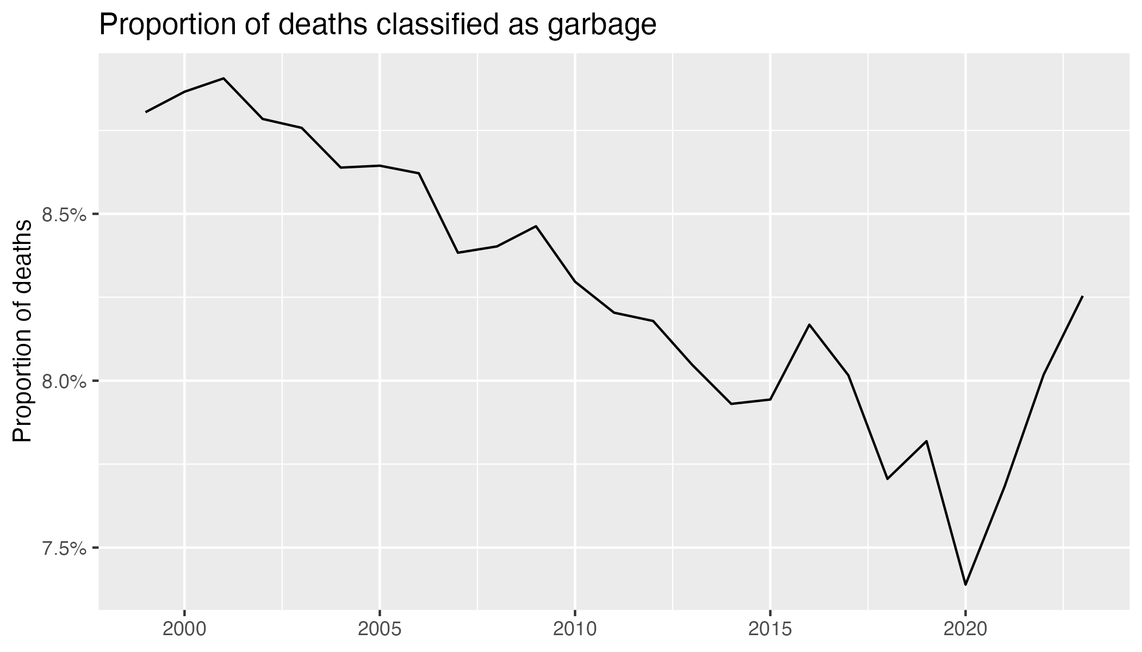

Slide 26
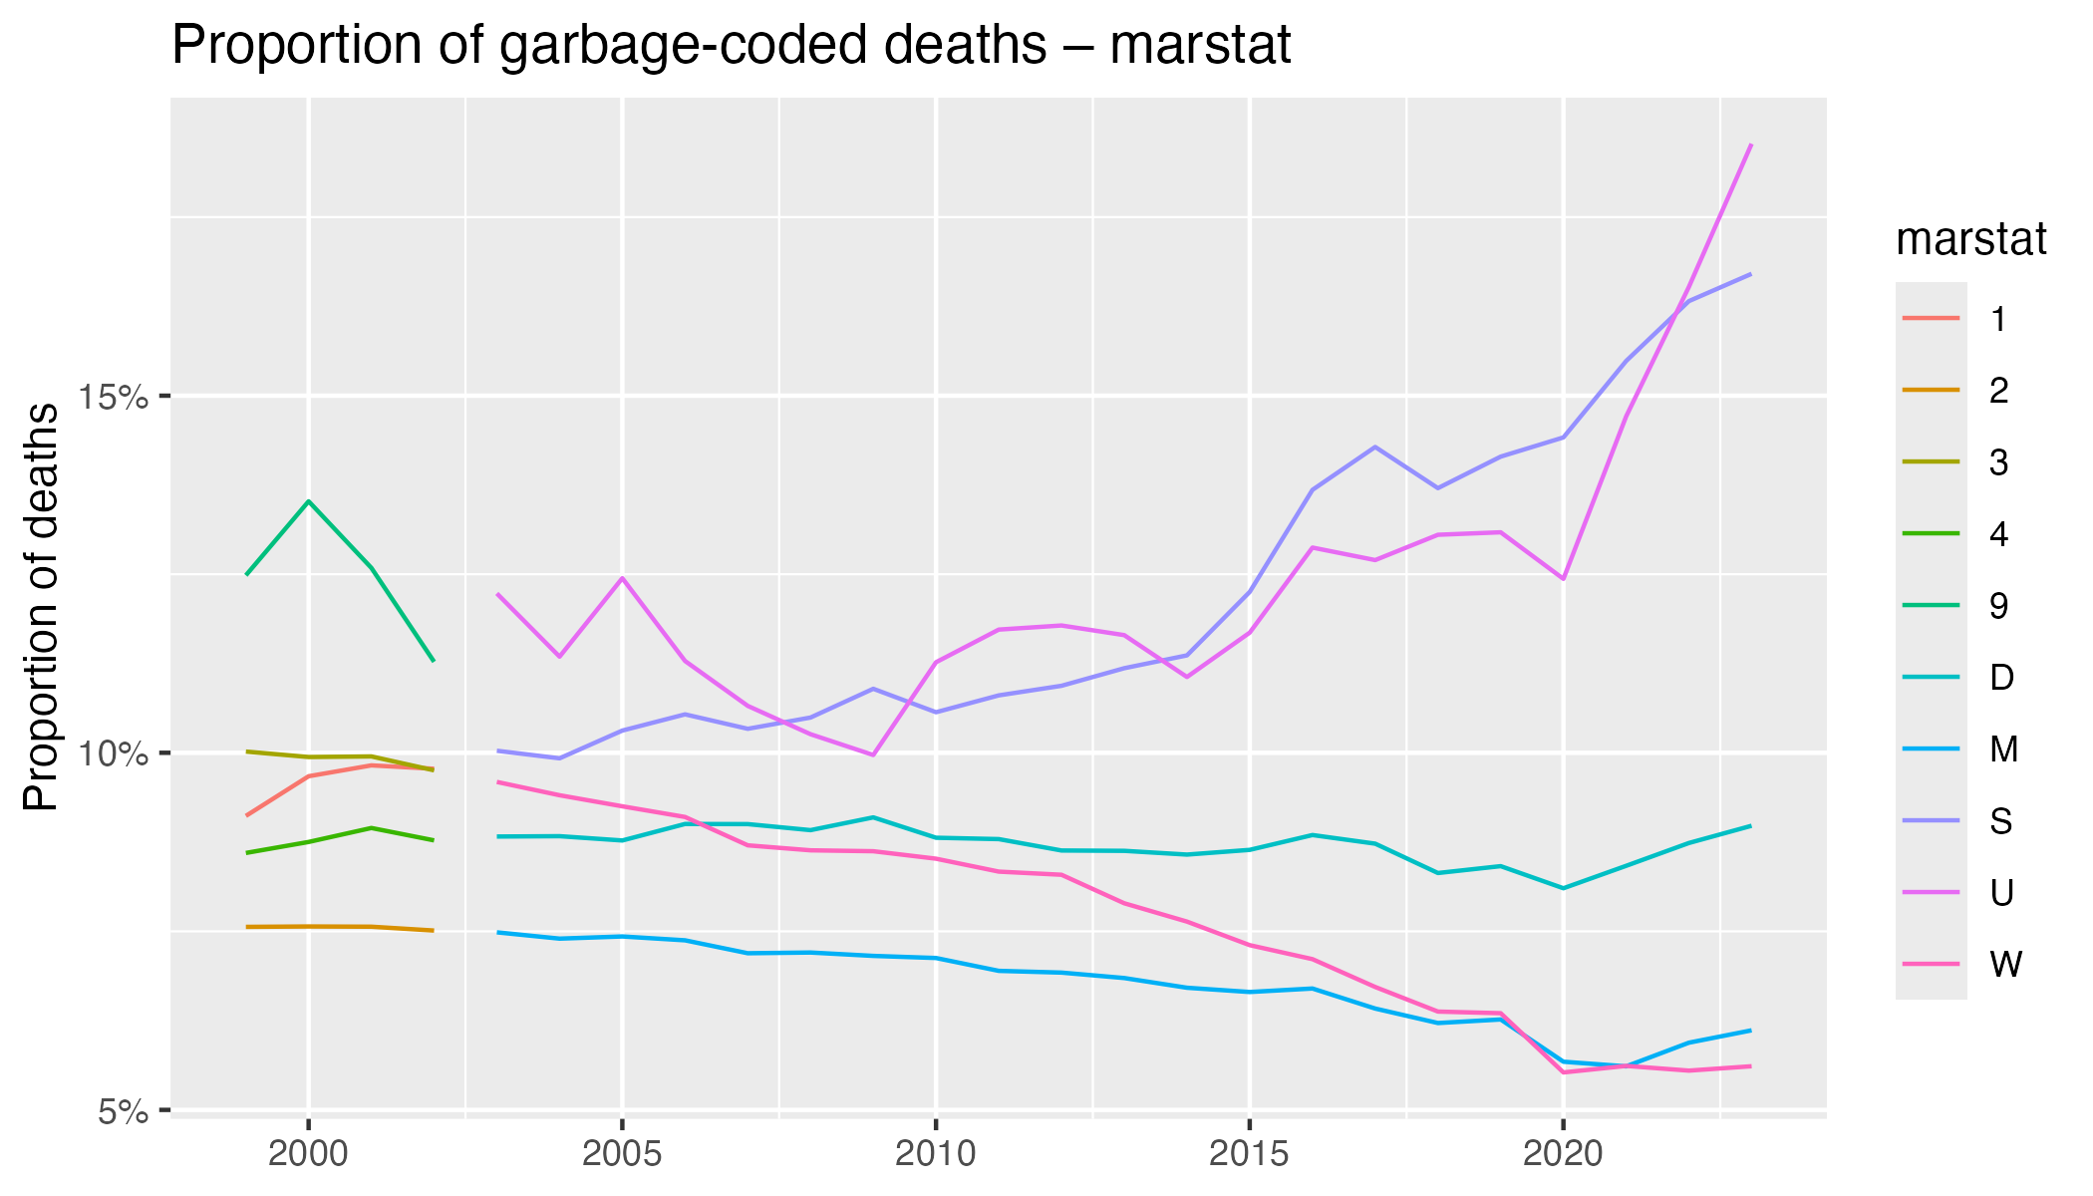

Slide 27
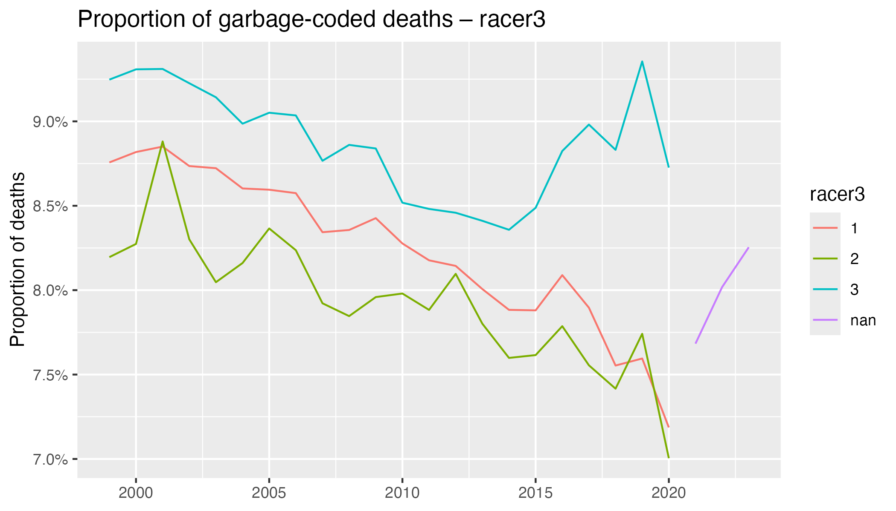

Slide 28
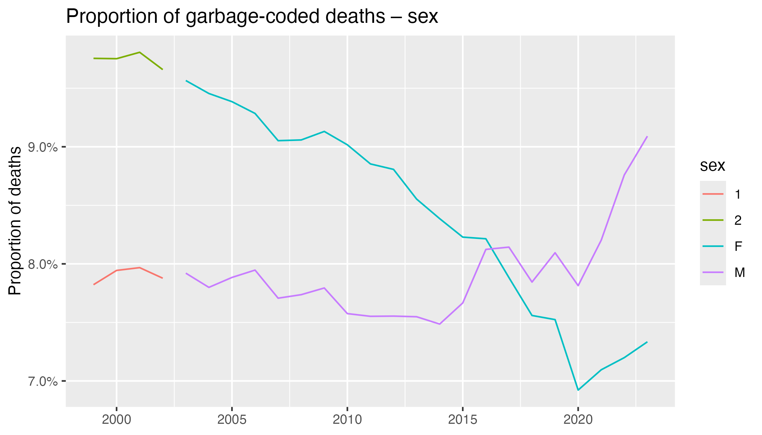

Slide 29
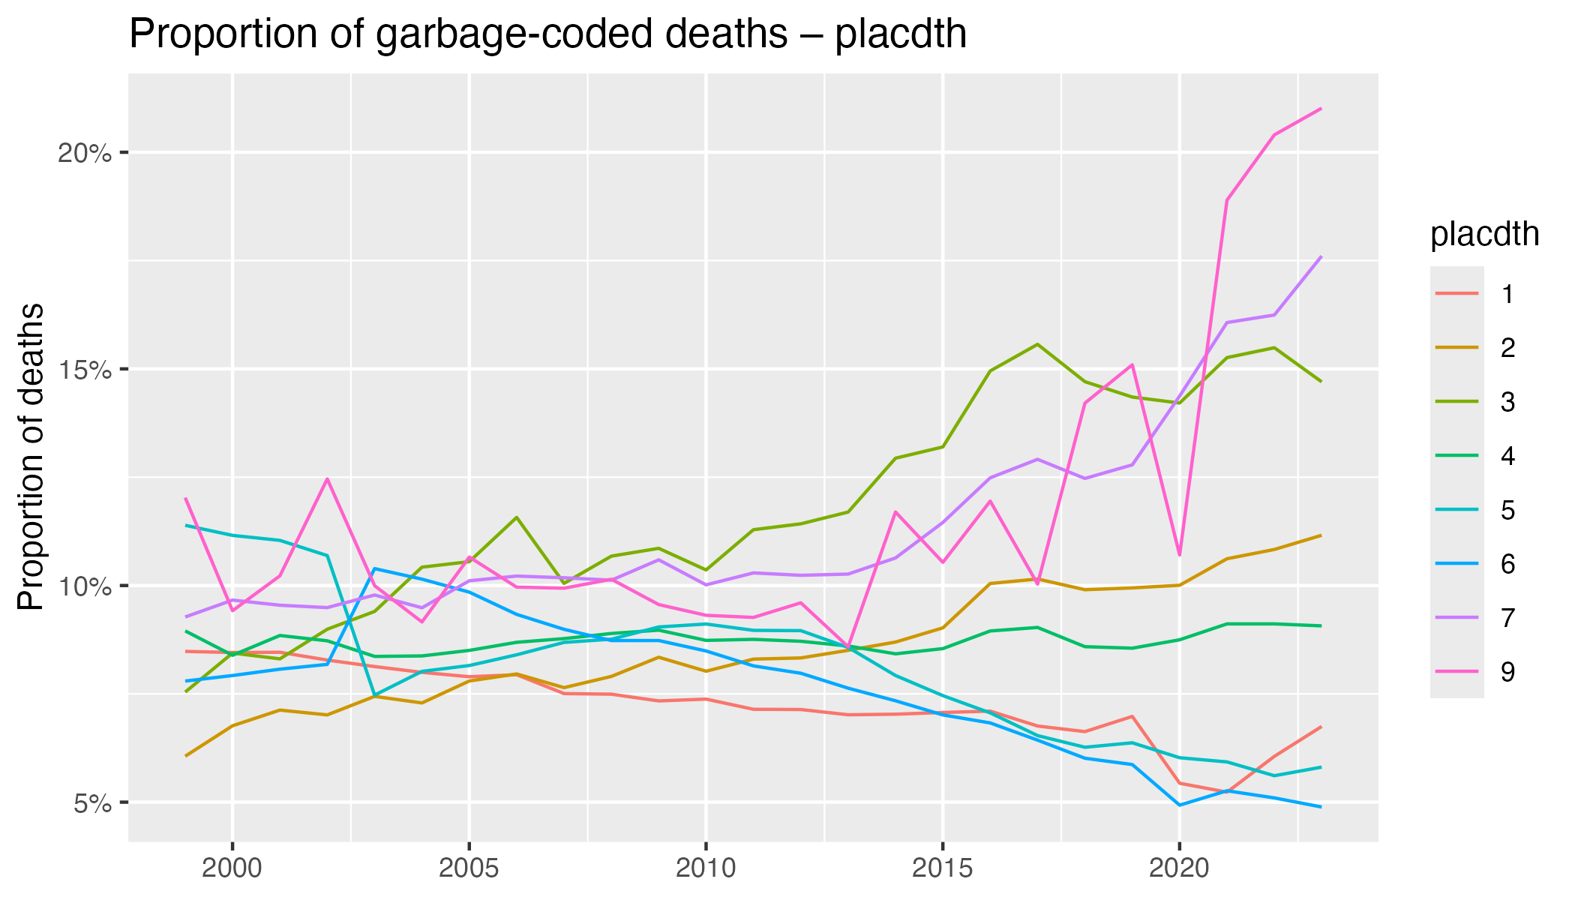
Hospital, clinic or Medical Center - Inpatient
Hospital, Clinic or Medical Center - Outpatient or admitted to Emergency Room
Hospital, Clinic or Medical Center - Dead on Arrival
Decedent’s home
Hospice facility
Nursing home/long term care
Other
Unknown* (very few)

Slide 30
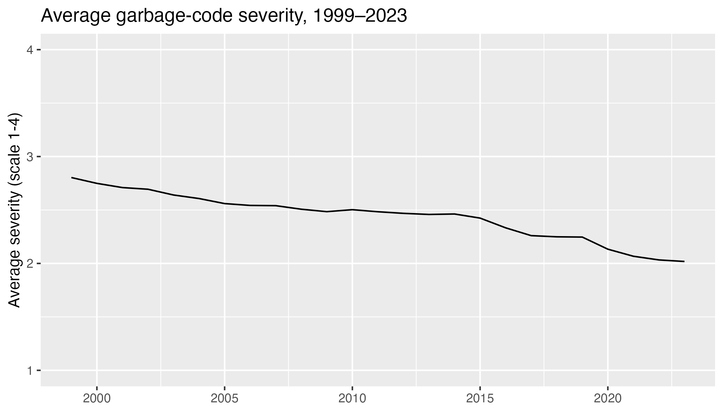

Slide 31
Quality of 2020 US Mortality Data

Slide 32
Fraction of Garbage Codes and GBD Severity Profile
In 2020, 7.4% of codes were garbage.
GBD Severity | Deaths | Share (of garbage codes)
1 | 119513 | 47.7%
2 | 33498 | 13.3%
3 | 42151 | 16.8%
4 | 55389 | 22.1%

Slide 33
Demographics and Percentage Garbage Codes
Race | Percentage garbage codes (%)
White | 7.2
Black | 8.7
Indigenous | 8.7
Asian or Pacific Islander | 6.5
Sex | Percentage garbage codes (%)
Female | 6.9
Male | 7.8
Marital Status | Percentage garbage codes (%)
Single | 14.4
Unknown | 12.4
Divorced | 8.1
Widowed | 5.7
Married | 5.5

Slide 34
Education Status | Percentage garbage codes (%)
8th grade or less | 5.8
9th - 12th grade, no diploma | 9.0
High school graduate or GED completed | 7.8
Some college credit, but no degree | 7.8
Associate degree | 7.0
Bachelor’s degree | 6.1
Master’s degree | 5.5
Doctorate or professional degree | 5.0
Unknown | 9.5
Day of the Week | Percentage garbage codes (%)
Monday | 7.7
Tuesday | 7.3
Wednesday | 7.3
Thursday | 7.3
Friday | 7.3
Saturday | 7.4
Sunday | 7.6
Unknown | 14.1
The educational gap widened considerably since 2016. (8th grade or less could be that they are in an older age cohort)

Slide 35
Place of Death | Percentage garbage codes (%)
Hospital, clinic or Medical Center - Inpatient | 5.4
Hospital, Clinic or Medical Center - Outpatient or admitted to Emergency Room | 10.0
Hospital, Clinic or Medical Center - Dead on Arrival | 14.2
Decedent’s home | 8.7
Hospice facility | 6.0
Nursing home/long term care | 4.9
Other | 14.4
Unknown* (only 70 deaths unknown) | 10.7

Slide 36
Industry | Number of Deaths | Percentage Garbage (%)
Accommodation and food services | 114297 | 11.4
Construction | 224718 | 10.5
Administrative, support, and waste services | 71397 | 9.5
Arts, entertainment, and recreation | 40455 | 8.7
Not submitted for I/O coding | 620735 | 8.1
Military | 307735 | 7.9
Other services (except public administration) | 146041 | 7.5
Retail trade | 220468 | 7.1
Healthcare and social assistance | 266800 | 6.9
Transportation and warehousing | 161474 | 6.8
Wholesale trade | 28368 | 6.7
Real estate, rental, and leasing | 37330 | 6.6
Mining | 22724 | 6.5
Information | 55612 | 6.4
Professional, scientific, and technical services | 113433 | 6.1
Manufacturing | 387090 | 6.1
Agriculture, forestry, fishing, and hunting | 68696 | 6.0
Utilities | 30273 | 5.9
Finance and Insurance | 88187 | 5.8
Education services | 203755 | 5.7
Public administration | 145672 | 5.5
Other–misc, missing | 31078 | 5.4
Management of companies and enterprises | 4596 | 5.0

Slide 37
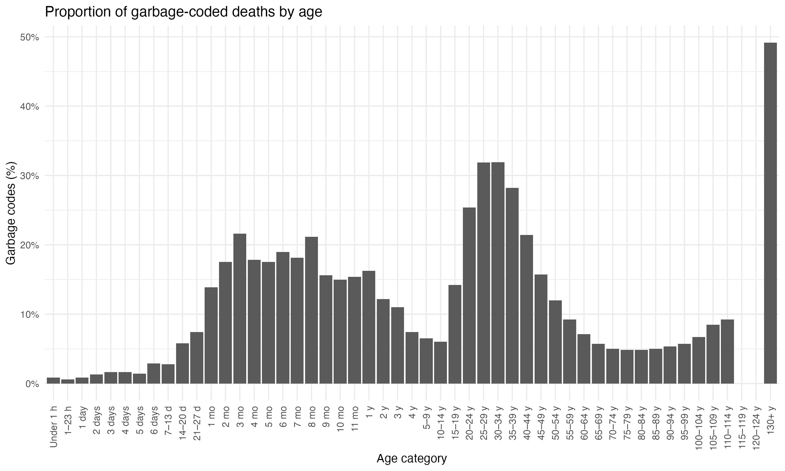
This looks almost the same as 2016.

Slide 38
Top 11 Garbage Codes in 2016
ICD10 | Description | GBD Severity Index | Deaths | Share (of garbage codes) | Trend since 2016
I64 | Stroke, not specified as haemorrhage or infarction | 4 | 53758 | 21.4% | ⚫️
X42 | Accidental poisoning by and exposure to narcotics and psychodysleptics [hallucinogens], not elsewhere classified | 1 | 39203 | 15.6% | ↑
X44 | Accidental poisoning by and exposure to other and unspecified drugs, medicaments and biological substances | 1 | 35654 | 14.2% | ↑
C80 | Malignant neoplasm without specification of site | 3 | 28885 | 11.5% | ↓
I10 | Essential (primary) hypertension | 2 | 26822 | 10.7% | ⚫️
R99 | Ill-defined and unknown cause of mortality | 1 | 12730 | 5.1% | ⚫️
X41 | Accidental poisoning by and exposure to antiepileptic, sedative-hypnotic, antiparkinsonism and psychotropic drugs, not elsewhere classified | 1 | 8970 | 3.6% | ↑
N19 | Unspecified kidney failure | 1 | 6358 | 2.5% | ↓
C55 | Malignant neoplasm of uterus, part unspecified | 3 | 5846 | 2.3% | ↓
C97 | Age-related physical debility | 1 | 4980 | 2.0% | ↑

Slide 39
Number of Secondary Factors
Race | Average # of Secondary Factors Listed
White | 1.26
Black | 1.25
Indigenous | 1.6
Asian or Pacific Islander | 1.3
Sex | Average # of Secondary Factors Listed
Female | 1.2
Male | 1.3
The detailedness decreased a lot.

Slide 40
Average Number of Secondary Factors by Marital Status
Marital Status | Average # of Secondary Factors
Single | 1.3
Unknown | 1.4
Divorced | 1.3
Widowed | 1.2
Married | 1.3
Education status similarly shows that more educated people have less secondary factors listed.

Slide 41
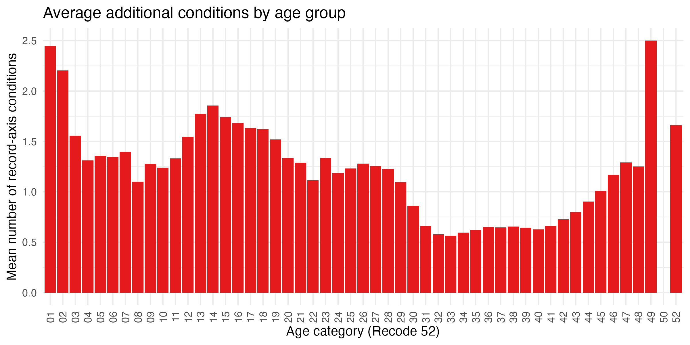

Slide 42
Proportion with 0 secondary factors listed
The average number of listed secondary factors was 1.99
Race | Percentage with 0 secondary factors listed
White | 15.1%
Black | 15.5%
Indigenous | 16.6%
Asian or Pacific Islander | 15.4%
Sex | Average # of Secondary Factors Listed
Female | 14.8%
Male | 15.6%

Slide 43
Proportion with 0 secondary factors listed
Marital Status | Percentage with 0 secondary factors (%)
Single | 15.2
Unknown | 15.7
Divorced | 15.6
Widowed | 14.6
Married | 15.3

Slide 44
Next steps:
2020 onwards has detailed occupation data which I was wondering if this could be used as a proxy for income or otherwise make use of it
Improve the time series and make ones for proportion with 0 secondary factors
Maps!
Other thoughts?

